Slide 1
ANGULAR 7

Slide 2
OBJECTIVE:
Installation Process
Features
Directives
Filters
Controllers
Services
Animation

Slide 3
Introduction
Angular is a framework to build a web application, which is becoming popular because of its unique features and ease to build an application. Angular 7 is an open source framework developed by Google. It completely relies on HTML and JavaScript. It converts a static HTML page into dynamic HTML page.
Angular2
Type Script
HTML
CSS

Slide 4
AngularJS provides developers an options to write client side applications using JavaScript in a clean Model View Controller (MVC) way.
Applications written in AngularJS are cross-browser compliant. AngularJS automatically handles JavaScript code suitable for each browser.
Overall, AngularJS is a framework to build large scale, high-performance, and easyto-maintain web applications.
AngularJS is a structural framework for dynamic web applications. It lets you use HTML as your template language and lets you extend HTML's syntax to express your application components clearly and succinctly.

Slide 5
Installation process
Step 1 :Install Node.js
Step 2: Install Angluar CLI
npm install -g @angular/cli
Step 3:create new project
ng new my-demo-app
Step 4:navigate to project directory
cd my-demo-app
Step5:To run the project
ng serve

Slide 6
Features
Native applications
Desktop applications
Progressive web applications
Universal support
Code splitting
Code generation
Testing
Animation Support
Accessibility

Slide 7
CLI Prompts
It helps users to make a decision. It asks users about “want to add routing? Y/N” and about the type of styles user want to use.

Slide 8
Commads
Sr.No | Commands and Description
1 | Component ng g component new-component
2 | Directive ng g directive new-directive
3 | Pipe ng g pipe new-pipe
4 | Service ng g service new-service
5 | Module ng g module my-module
6 | Test ng test
7 | Build ng build --configuration=production // for production environment ng build --configuration=staging // for stating environment

Slide 9
Controllers
AngularJS application mainly relies on controllers to control the flow of data in the application. A controller is defined using ng-controller directive. A controller is a JavaScript object that contains attributes/properties, and functions. Each controller accepts $scope as a parameter, which refers to the application/module that the controller needs to handle.
ng-app=“”ng-controller=“controller name”

Slide 10
Directives
AngularJS directives are used to extend HTML. They are special attributes starting with ng-prefix. Let us discuss the following directives −
ng-app − This directive starts an AngularJS Application.
ng-init − This directive initializes application data.
ng-model − This directive defines the model that is variable to be used in AngularJS.
ng-repeat − This directive repeats HTML elements for each item in a collection.

Slide 11
Filters
Currency Filter
Add currency filter to an expression returning number using pipe character. Here we've added currency filter to print fees using currency format.
OrderBy Filter
To order subjects by marks, we use orderBy marks.

Slide 12
Modules
AngularJS supports modular approach. Modules are used to separate logic such as services, controllers, application etc. from the code and maintain the code clean.
We define modules in separate js files and name them as per the module.js file.
They are two types of modules
Application Module − used to initialize an application with controller(s).
Controller Module − used to define the controller.

Slide 13
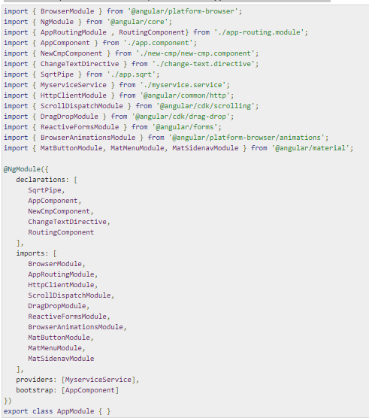
module – app.module.ts as shown below

Slide 14
Forms
AngularJS enriches form filling and validation. We can use ng-click event to handle the click button and use $dirty and $invalid flags to do the validation in a seamless way.
Use no validate with a form declaration to disable any browser-specific validation.
The form controls make heavy use of AngularJS events. Let us have a look at the events first.
Validate Data
The following can be used to track error.
$dirty − states that value has been changed.
$invalid − states that value entered is invalid.
$error − states the exact error.

Slide 15
Services
There are two ways to create a service −
Factory
Service
Using Factory Method
In this method, we first define a factory and then assign method to it.
Using Service Method
In this method, we define a service and then assign method to it. We also inject an already available service to it.

Slide 16
Application Performance
Earlier reflect-metadata is used in production but it is required at the time of development. Therefore, ployfill.ts is removed by default in angular 7.

Slide 17
Virtual Scrolling
Google accelerates the speed of Angular 7 for a huge scrollable list.
Start with a plain Angular table
We’re starting with a pretty simple example of a table using a *ngFor loop

Slide 18
1 2 3 4 5 6 7 8 9 10 11 12 13 14 15 | <table> <thead> <tr> <td>Name</td> <td>ID</td> </tr> </thead> <tbody> <tr *ngFor="let row of tableData"> <td>{{row.name}}</td> <td>{{row.id}}</td> </tr> </tbody> </table>

Slide 19
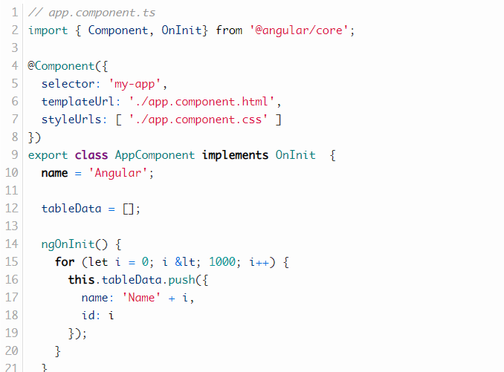
The tableData property is defined in the corresponding component.ts file.

Slide 20

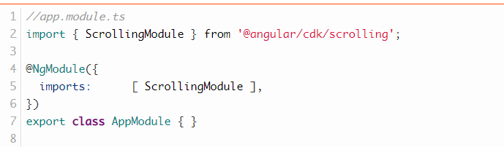
Introducing virtual scrolling
The Angular CDK provides a scrolling component. We’re now going to add it to our plain table in 4 simple steps.
1. Add the dependency
2. Add ScrollingModule

Slide 21
3. Add Scrolling Component
Step 2 is to add the <cdk-virtual-scroll-viewport> element around the markup of your table. We need to provide the attribute [itemSize]=”heightOfRowInPx” that tells the scrolling component how high each row is.
4. replace *ngFor with *cdkVirtualFor
instead of using *ngFor we’re going to use *cdkVirtualFor that is needed in order for the virtual scrolling to work as intended.

Slide 22
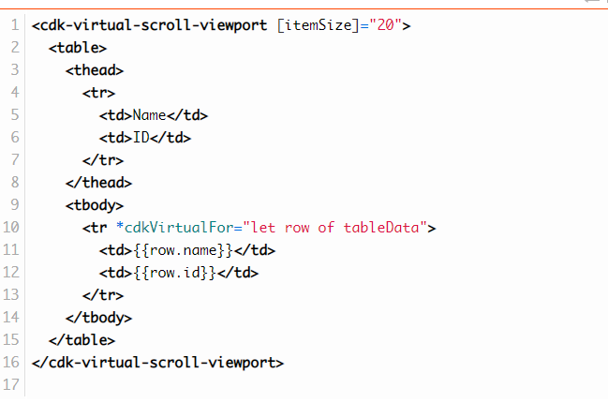

Slide 23
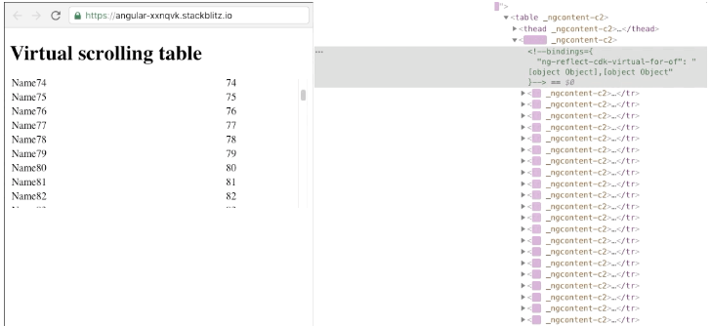
Result..
If we inspect the DOM changes after introducing the <cdk-virtual-scroll-viewport> we see that the browser is removing and adding DOM Nodes as we are scrolling.

Slide 24
4. Drag and Drop
It comes with the feature of automatic rendering.
5.Bundle Budget
If the bundle size is more than 2MB, a warning message provided and for above 5MB, an error will be given.

Slide 25
Animation
Animations add a lot of interaction between the html elements. Animation was available with Angular 2, from Angular 4 onwards animation is no more a part of the @angular/core library, but is a separate package that needs to be imported in app.module.ts.

Slide 26
To start with, we need to import the library with the below line of code

Slide 27
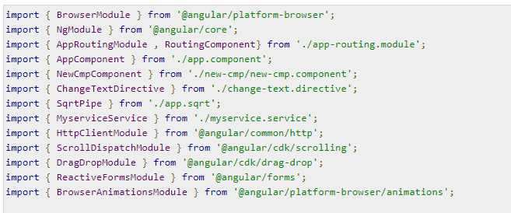
The BrowserAnimationsModule needs to be added to the import array in app.module.ts as shown below −

Slide 28
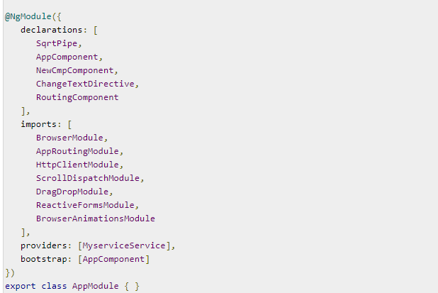

Slide 29
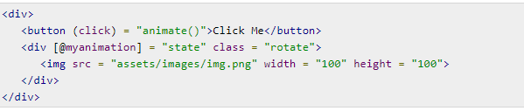
In app.component.html, we have added the html elements, which are to be animated.
Let us now see the app.component.ts where the animation is defined.

Slide 30
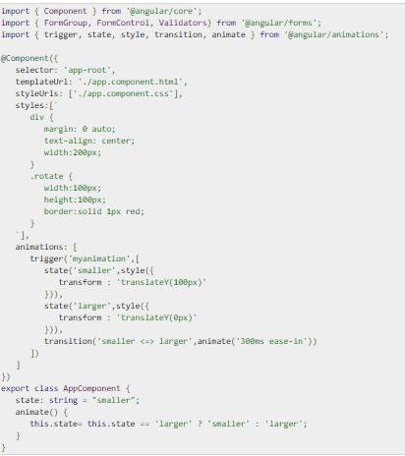

Slide 31
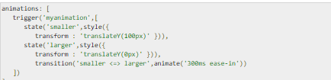
We have to import the animation function that is to be used in the .ts file as shown above.
Here we have imported trigger, state, style, transition, and animate from @angular/animations.
Now, we will add the animations property to the @Component () decorator −

